Slide 1
Data and Performance Aggregation
October 11, 2023

Slide 2
Today’s Presenter from Mason
Will Thorpe
wthorpe@masoncompanies.com
703-716-6000
Chief Marketing and Development Officer

Slide 3
What is Data Aggregation?

Slide 4
Mason – In Brief
Who is Mason
Who we serve
How we excel
Mason is an independent, community foundation-focused advisory firm that has provided quality wealth and investment management services for over 40 years.
Mason serves a variety of institutional and private clients including:
Mason is a thought leader offering sophisticated approaches to:
50 Community Foundations
Asset Allocation & Rebalancing
30+ Credentialed Professionals
31 Additional Institutional Clients
Manager Selection
HNW Individuals & Families
Private Equity Investing
Clients in 44 states
$10.9 B AUM
Data Aggregation & Reporting
CNBC “Top 100 Financial Advisors”
Barron’s “Top 100 Institutional Investment Consulting Teams”

Slide 5
Committed to Those Who Serve
We help impact-driven organizations realize their potential by providing comprehensive, high-quality investment management and administrative services delivered with an independent and objective voice.
Mason’s mission:

Slide 6
A Rigorous Investment Process
We apply a disciplined, multi-step investment process to create, manage and grow investment portfolios that align closely with your goals and resources.
1
2
3
4
Assessment
Strategy
Implementation
Management
Exploring:
Goals and investment objectives
Cash flows
Spending requirements
Determining:
Strategic asset allocation
Risk & return management
Investment/spending policy review
Completing:
Manager review and selection
Account set up and transactions
Monitoring:
Manager performance
Rebalancing process
Performance reporting
Education and training
Donor development

Slide 7
Assessment Getting to Know You
1
To build your customized portfolio we focus on your investment objectives, spending needs, risk tolerance, and time horizon.
Setting your: Portfolio Allocation Target
All Cash
Cash, Fixed Income & Equity
All Equity
DEPENDS ON DETERMINING YOUR:
Investment Objectives
Stability of Principal
Growth
Spending Needs
Potential for Loss of Purchasing Power
Potential for Real Growth in Spending Ability
Risk Tolerance
Low
High
Time Horizon
Shorter
Longer

Slide 8
Strategy Allocating Assets
2
Your allocation strategy is designed to optimize your targeted risk-return profile.
Use a broad range of asset classes to enhance the potential to achieve return targets while managing risk.
Optimize your asset allocation through sophisticated portfolio modeling based on historical risk and return data.
Apply a long-term strategic approach to asset allocation, avoiding short- or short-intermediate tactical adjustments to your portfolio.
Maintain your allocation strategies by implementing disciplined, research-based rebalancing.
Asset Classes
Cash | International Growth
Short Term Fixed Income | Real Estate
Intermediate Fixed Income | Small Value
TIPS | Small Growth
International Fixed Income | International Small Cap
Large Value | Energy
Large Growth | Natural Resources
International Value | Private Equity
Safety
Income
Growth
Aggressive

Slide 9
Annual Asset Class Leaders
2006 | 2007 | 2008 | 2009 | 2010 | 2011 | 2012 | 2013 | 2014 | 2015 | 2016 | 2017 | 2018 | 2019 | 2020 | 2021 | 2022 | Through 06/30/23
REIT | Energy | Cash | Energy | Small Gr. | TIPS | Intl Gr. | Small Gr. | REIT | Intl. SC | Energy | Intl Gr. | Cash | Large Gr. | Small Gr. | Energy | Energy | Large Gr.
Intl. Val. | Nat. Res. | Zero | Nat. Res. | REIT | REIT | REIT | Small Val. | Large Val. | Large Gr. | Nat. Res. | Large Gr. | ST Bond | Intl Gr. | Large Gr. | REIT | Cash | Intl Gr.
Intl Gr. | Intl Gr. | Intl. Bond | Intl. SC | Small Val. | IT Bond | Intl. Val. | Large Gr. | Large Gr. | REIT | Small Val. | Intl. SC | Zero | Small Gr. | Intl Gr. | Small Val. | Zero | Small Gr.
Large Val. | Large Gr. | TIPS | Intl Gr. | Intl. SC | Intl. Bond | Small Val. | Large Val. | IT Bond | Intl Gr. | Large Val. | Intl. Val. | IT Bond | REIT | Nat. Res. | Nat. Res. | Nat. Res. | Intl. Val.
Intl. SC | TIPS | ST Bond | Large Gr. | Nat. Res. | ST Bond | Large Gr. | Energy | Small Val. | ST Bond | Small Gr. | Small Gr. | Intl. Bond | Large Val. | Intl. SC | Large Val. | ST Bond | Small Val.
Small Val. | Intl. Val. | IT Bond | Small Gr. | Energy | Cash | Large Val. | Intl. Val. | Small Gr. | Cash | REIT | Large Val. | TIPS | Small Val. | TIPS | Large Gr. | Large Val. | Large Val.
Energy | Small Gr. | Small Val. | REIT | Large Gr. | Zero | Intl. SC | Intl. SC | TIPS | Zero | Intl. SC | Nat. Res. | Large Gr. | Intl. Val. | Intl. Bond | Small Gr. | Intl. Val. | REIT
Small Gr. | Intl. Bond | Large Val. | Small Val. | Intl Gr. | Large Val. | Small Gr. | Intl Gr. | Intl. Bond | IT Bond | TIPS | Small Val. | Small Gr. | Intl. SC | IT Bond | Intl. Val. | TIPS | Intl. SC
Nat. Res. | Intl. SC | Large Gr. | Intl. Val. | Large Val. | Large Gr. | Intl. Bond | Nat. Res. | ST Bond | TIPS | Intl. Bond | Intl. Bond | REIT | Nat. Res. | Small Val. | Intl. SC | Small Val. | Nat. Res.
Large Gr. | IT Bond | Small Gr. | Large Val. | IT Bond | Small Gr. | IT Bond | REIT | Cash | Small Gr. | IT Bond | REIT | Large Val. | IT Bond | ST Bond | Intl Gr. | IT Bond | Cash
Intl. Bond | Cash | REIT | Intl. Bond | Intl. Val. | Small Val. | TIPS | ST Bond | Zero | Intl. Val. | Large Gr. | IT Bond | Intl Gr. | TIPS | Large Val. | TIPS | Intl. Bond | IT Bond
Cash | ST Bond | Intl. Val. | IT Bond | Intl. Bond | Energy | Nat. Res. | Cash | Intl Gr. | Large Val. | Intl. Val. | TIPS | Small Val. | Energy | Intl. Val. | ST Bond | Intl. SC | Intl. Bond
IT Bond | Large Val. | Intl Gr. | TIPS | TIPS | Intl Gr. | ST Bond | Zero | Intl. SC | Intl. Bond | ST Bond | ST Bond | Intl. Val. | Intl. Bond | Cash | Cash | Intl Gr. | ST Bond
ST Bond | Zero | Nat. Res. | ST Bond | ST Bond | Intl. Val. | Energy | IT Bond | Intl. Val. | Small Val. | Cash | Cash | Nat. Res. | ST Bond | Zero | Zero | REIT | TIPS
Zero | Small Val. | Intl. SC | Cash | Cash | Nat. Res. | Cash | Intl. Bond | Nat. Res. | Nat. Res. | Zero | Zero | Intl. SC | Cash | REIT | IT Bond | Small Gr. | Zero
TIPS | REIT | Energy | Zero | Zero | Intl. SC | Zero | TIPS | Energy | Energy | Intl Gr. | Energy | Energy | Zero | Energy | Intl. Bond | Large Gr. | Energy
All Cash
Cash, Fixed Income & Equity
All Equity

Slide 10
Implementation A Powerful Approach to Fund Selection
3
We strive to select the best investment firms and funds for each asset class in your portfolio.
Our Fund Selection Approach
Fund Family Universe
We begin by researching the fund families
Result:
Improved consistency and predictability of returns over the long-term
Top Fund Families
Through quantitative and qualitative screens, we select what we believe to be the “best” fund families
Top Funds by Family
We choose what we believe to be the best funds in each asset class from top-performing fund families
Top Funds by Asset Class
We use a mix of active and passive managers and may have more than one fund per asset class for added diversification

Slide 11
Management Portfolio Review: Disciplined Rebalancing
4
Our proprietary research has found:
Review portfolios every 10 days
Rebalance if asset classes are above or below 30% band
Fiduciary purpose is to maintain original risk/return parameters
Typical portfolio is rebalanced one to three times per year
Mason studies show 0.20% to 0.40% potential performance increase with lower risk
Our Rebalancing Ranges
Over
Weight
13%
Upper Band
}
Target
30%
10%
}
30%
7%
Lower Band
Under
Weight

Slide 12
Data Aggregation

Slide 13
An Efficient Data Aggregation Process
Manager
Advisor
Mutual Fund
Broker
Custodian
Bank
Daily Download
Data Capture
Investment Classification & Organization
Portfolio Management
Mason utilizes several software services to collect account data.
Transactions
Contributions
Withdrawals
Fees
Charges
Prices
Positions
Portfolio Monitoring & Rebalancing
Black Diamond
Daily Reconciliation*
Monthly Accounting Reports
Quarterly Performance Reports
*Data capture may be done monthly via manual data entry – depends upon custodian’s systems.
Portfolio Reporting

Slide 14
The Benefits of Data Aggregation
Data aggregation can provide a more comprehensive view of your investments and enable more informed decision-making.
Data aggregation addresses the following challenges:
Data integrity
Data provided by advisors may be incomplete and or inconsistent
Duplicate investments/allocations at each local advisor
Performance tracking
Performance reporting process complex and time intensive
Rebalancing strategy not as efficient as desired
Investment performance not meeting expectations for multi-advisor pooled accounts
Managing advisors
Local advisor coordination process can be challenging
Desire to keep and grow local advisor relationships
Desire to enhance their portfolio management process

Slide 15
An Efficient Data Aggregation Process
We help you gain deeper financial insight at the total portfolio level, as well as across all your individual accounts, so you can make more informed decisions with less legwork.
Enhanced data integrity
Multi-advisor/custodian capabilities
Aggregate asset allocation tracking
Comprehensive performance reporting

Slide 16
Differences in Data Presentation (1 of 2)
Inconsistencies in Accounting and Reporting
Trade date vs. settlement date
Net of fees vs. gross of fees
Treatment of management fees (loss vs. flow)
Annualized returns vs. cumulative returns
Benchmarking
Return calculations
Daily time-weighted, monthly time-weighted, period time-weighted

Slide 17
Differences in Data Presentation (2 of 2)
Inconsistencies in Accounting and Reporting
Time-weighted returns vs. dollar/money weighted returns
End date/valuation differences (some statements go through the end of the month, some through the last Friday of the month)
PE and some hedge funds are on a lag
Actual returns vs. composite/historical (non-client) returns
Account performance vs. portfolio performance
Detailed security information vs. top-line information
Security classifications

Slide 18
Reporting Levels
Levels of Reporting
(Varies Depending Upon Custodian)
Portfolio Level
Asset Class Level
Security/Mutual Fund Level
Transactions Level

Slide 19
Performance Reporting Detail
Performance By Asset Class
Security/Asset Class Name
Beginning Market Value
Contributions/Withdrawals
Realized and Unrealized Gains
Interest/Dividends
Ending Market Value
Asset Allocation – Current Percentage and Policy Target Percentage
Asset Class Performance – of Your Portfolio
Asset Class Performance – of the Comparable Peer Group Benchmark
Transactions Level Data
Beginning/Ending Market Value
Interest
Change in Accrued Interest
Dividends
Realized/ Unrealized Gain/Loss on Market Value
Realized/ Unrealized Gain/Loss on Cost Basis
Total Fees
External Additions/Withdrawals
Transfers In/Out
Performance By Manager
Security/Asset Class Name
Beginning Market Value
Contributions/Withdrawals
Realized Gains
Unrealized Gains
Interest/Dividends
Ending Market Value
Investment Manager Performance
Peer Group Benchmark Performance

Slide 20
Client Portal Screen Samples and Sample Report Pages

Slide 21
Client Portal Screen Samples
Activity summaries
1
Asset allocation
2
Allocation vs. policy targets
3
Performance
4
Gains and losses
5
Transaction summary
6

Slide 22
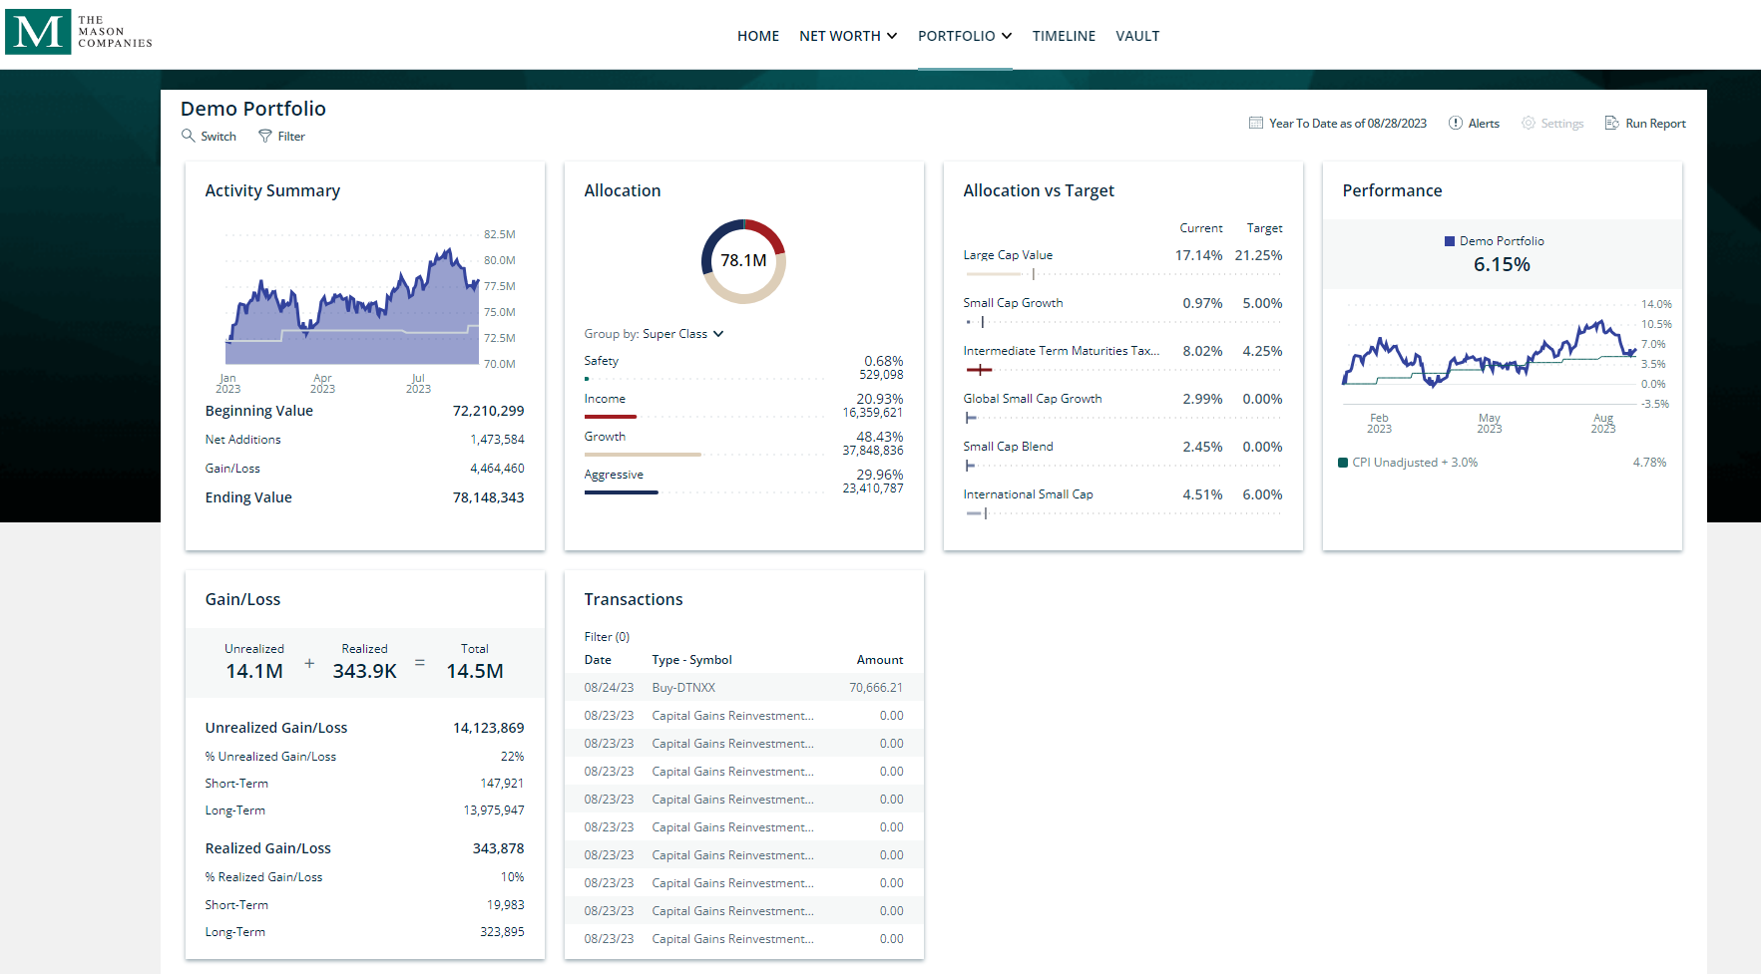
Reporting – Client Portal Sample Screens Daily Views of Client Information
All Cash
Cash, Fixed Income & Equity
All Equity

Slide 23
Sample Monthly/Quarterly Report Pages
Asset allocation, and fiduciary tracking
1
Change in market value
2
Gain and loss report – realized and unrealized
3
Income and expenses
4
Purchases and sales
5
Transaction summary
6

Slide 24
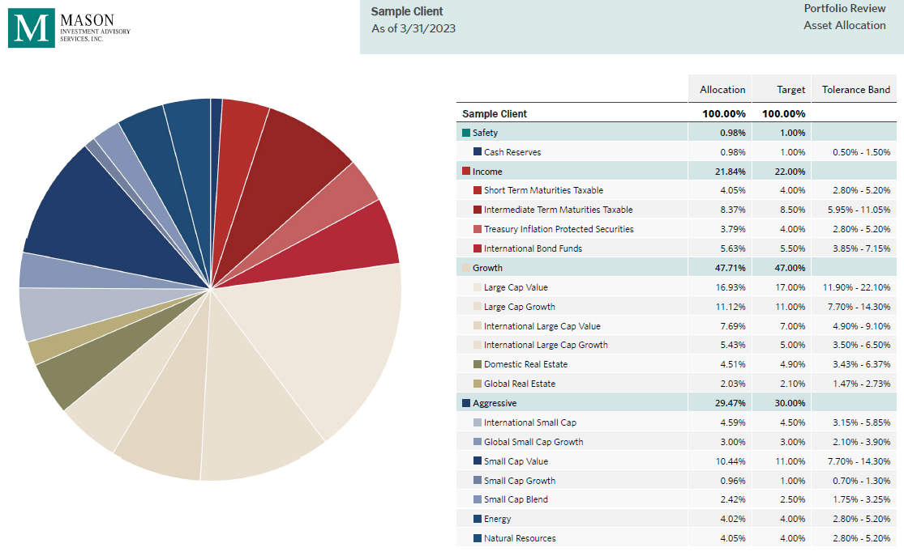
Reporting – Sample Pages Save Time & Improve Data Accuracy
All Cash
Cash, Fixed Income & Equity
All Equity

Slide 25
Reporting – Sample Pages Save Time & Improve Data Accuracy
All Cash
Cash, Fixed Income & Equity
All Equity

Slide 26
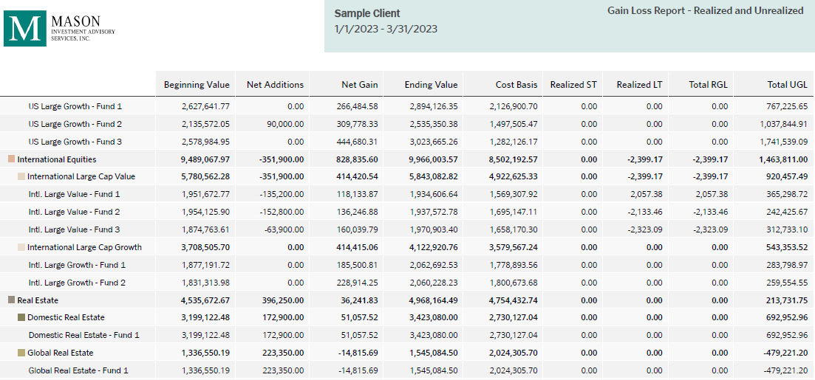
Reporting – Sample Pages Save Time & Improve Data Accuracy
All Cash
Cash, Fixed Income & Equity
All Equity

Slide 27
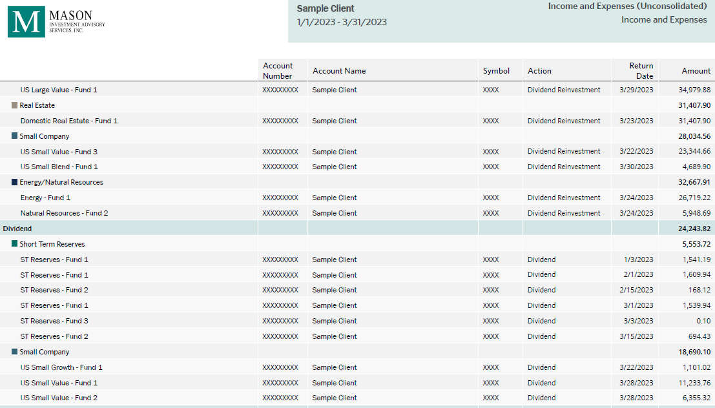
Reporting – Sample Pages Save Time & Improve Data Accuracy
All Cash
Cash, Fixed Income & Equity
All Equity

Slide 28
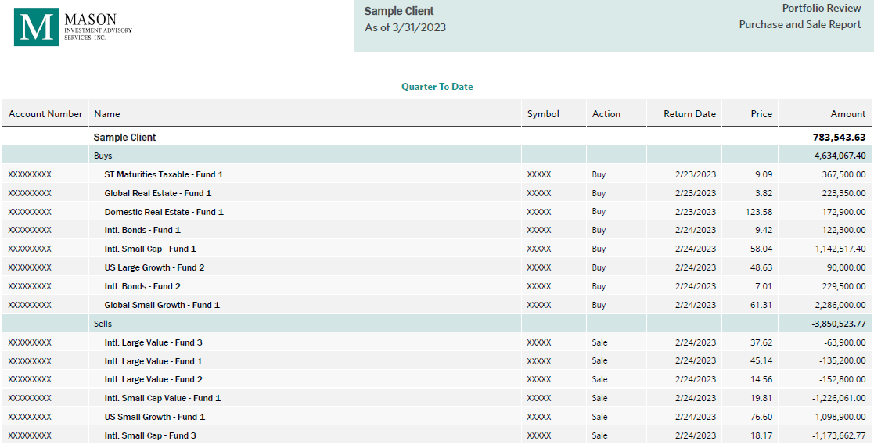
Reporting – Sample Pages Save Time & Improve Data Accuracy
All Cash
Cash, Fixed Income & Equity
All Equity

Slide 29
Reporting – Sample Pages Save Time & Improve Data Accuracy
All Cash
Cash, Fixed Income & Equity
All Equity

Slide 30
Disclosures

Slide 31
Additional Details
Annual Asset Class Leaders
Performance of the Morningstar Categories and the index used for Cash was derived from the Morningstar Direct. All data is derived as of June 30, 2023.
In an effort to distinguish funds by what they own, as well as by their prospectus objectives and styles, Morningstar developed the Morningstar Categories. While the prospectus objective identifies a fund’s investment goals based on the wording in the fund prospectus, the Morningstar Category identifies funds based on their actual investment styles as measured by their underlying portfolio holdings (portfolio statistics and compositions over the past three years). If the fund is new and has no portfolio, Morningstar estimates where it will fall before assigning a more permanent category. When necessary, Morningstar may change a category assignment based on current information.
The following is a description of the Morningstar Categories and indices used in the illustration.
Short-Term Bond Category: Short-term bond portfolios invest primarily in corporate and other investment-grade U.S. fixed-income issues and have durations of one to 3.5 years (or, if duration is unavailable, average effective maturities of one to four years). These portfolios are attractive to fairly conservative investors, because they are less sensitive to interest rates than portfolios with longer durations.
Intermediate-Term Bond Category: Intermediate-term bond portfolios invest primarily in corporate and other investment-grade U.S. fixed-income issues and have durations of 3.5 to six years (or if duration is unavailable, average effective maturities of four to 10 years). These portfolios are less sensitive to interest rates, and therefore less volatile, than portfolios that have longer durations.
Inflation-Protected Bond Category: Inflation-protected bond portfolios invest primarily in debt securities that adjust their principal values in line with the rate of inflation. These bonds can be issued by any organization, but the U.S. Treasury is currently the largest issuer for these securities.
World Bond Category: World bond portfolios invest 40% or more of their assets in foreign bonds. Some world bond portfolios follow a conservative approach, favoring high-quality bonds from developed markets. Others are more adventurous, and own some lower-quality bonds from developed or emerging markets. Some portfolios invest exclusively outside the U.S. while others regularly invest in both U.S. and non-U.S. bonds.
Large Value: Large-value portfolios invest primarily in big U.S. companies that are less expensive or growing more slowly than other large-cap stocks. Stocks in the top 70% of the capitalization of the U.S. equity market are defined as large-cap. Value is defined based on low valuations (low price ratios and high dividend yields) and slow growth (low growth rates for earnings, sales, book value, and cash flow).
Large Growth: Large-growth portfolios invest in big U.S. companies that are projected to grow faster than other large-cap stocks. Stocks in the top 70% of the capitalization of the U.S. equity market are defined as large-cap. Growth is defined based on fast growth (high growth rates for earnings, sales, book value, and cash flow) and high valuations (high price rations and low dividend yields). Most of these portfolios focus on companies in rapidly expanding industries.
Small Value: Small-value portfolios invest in small U.S companies with valuations and growth rates below other small-cap peers. Stocks in the bottom 10% of the capitalization of the U.S. equity market are defined as small-cap. Value is defined based on low valuations (low price ratios and high dividend yields) and slow growth (low growth rates for earnings, sales, book value, and cash flow).
Small Growth: Small-growth portfolios focus on faster-growing companies whose shares are at the lower end of the market-capitalization range. These portfolios tend to favor companies in the up-and-coming industries or young firms in their early growth stages. Stocks in the bottom 10% of the capitalization of the U.S. equity market are defined as small-cap. Growth is defined based on fast growth (high growth rates for earnings, sales, book value, and cash flow) and high valuations (high price rations and low dividend yields). Most of these portfolios focus on companies in rapidly expanding industries.
Real Estate Category: Real estate portfolios invest primarily in real-estate investment trusts (REITs) of various types. REITs are companies that develop and manage real-estate properties. There are several different types of REITs, including apartment, factory-outlet, health-care, hotel, industrial, mortgage, office, and shopping center REITs.
International Large Value Category: International large-value portfolios invest mainly in big international stocks that are less expensive or growing more slowly than other large-cap stocks. Most of these portfolios divide their assets among a dozen or more developed markets, including Japan, Britain, France, and Germany. These portfolios primarily invest in stocks that have market caps in the top 70% of each economically integrated market (such as Europe or Asia ex-Japan). Value is defined based on low valuations (low price ratios and high dividend yields) and slow growth (low growth rates for earnings, sales, book value, and cash flow). International Large Value is referred to as Foreign Large Value in Morningstar.
International Large Growth Category: International large-growth portfolios focus on high-priced growth stocks, mainly outside of the United States. Most of these portfolios divide their assets among a dozen or more developed markets, including Japan, Britain, France, and Germany. These portfolios primarily invest in stocks that have market caps in the top 70% of each economically integrated market (such as Europe or Asia ex-Japan). Growth is defined based on fast growth (high growth rates for earnings, sales, book value, and cash flow) and high valuations (high price rations and low dividend yields). International Large Growth is referred to as Foreign Large Growth in Morningstar.
International Small Cap Category: The S&P Developed Ex US Cap Range <$2 billion index was used to illustrate the performance of International Small Cap. This index is a market capitalization weighted index that defines and measure the investable universe of publicly traded companies domiciled in developed countries outside the U.S.
Natural Resources Category: Natural resources portfolios focus on commodity-based industries such as energy, chemicals, minerals, and forest products in the U.S. or outside of the U.S.
Energy Category: Equity energy portfolios invest primarily in equity securities of U.S. or non-U.S. companies who conduct business primarily in energy-related industries. This includes, but is not limited to companies in alternative energy, coal, exploration, oil and gas services, pipelines, natural gas services and refineries.
Cash: Three-month T-bills were used to illustrate the performance of cash. Three-month T-=Bills are government-backed short-term investment considered to be a reasonable cash proxy because the maturity is only three months and they are guaranteed by the US Government.

