Slide 1

Investing in Hope:
Children’s Savings Accounts
Paula Gruszynski, Executive Director of M&M Community Foundation
Chelsea Wunnicke, WI College Savings Program, DFI
Notes:
Chelsea: Children’s Savings Accounts are about planting seeds for the future, like you see here. They are about adults helping children see their potential for the future, and helping them work toward it. Imagine if you were this woman…what do you think she’s telling this child? and you asked the child here: “do you think any beans will get picked here in this garden this summer?”…what do you think she would say… “Yes—because you gave me the seeds, and helped me plant them, I know that beans are going to grow here, and I want to be here to pick them!” So you see, when you give a child something for their future, and you help show them the future that it creates, they believe you and they bring their mindset and their actions into alignment to help create that future.

Slide 2
Agenda
Level setting
  What are Children’s Savings Account Program?
A story of success
  M&M Area Community Foundation
Partnership Opportunities
  Wisconsin 529 College Savings Program and UW Extension
Notes:
Chelsea briefly review agenda.

Slide 3


Your speakers today
Chelsea Wunnicke
  Wisconsin College Savings Program, Department of Financial Institutions
Paula Gruszynski
  M&M Area Community Foundation
Wisconsin College Savings Program, DFI
https://www.mmacf.org/
Notes:
Introduce ourselves

Slide 4

Foundational Research
Learn more with UW Extension’s Youth Forward Wisconsin Program
https://finances.extension.wisc.edu/topics/youth-forward-wisconsin/
Notes:
Chelsea: In the first example, about planting seeds in a garden, we gave an illustration about how mindset and attitudes about the future are shaped by gifts and investments made today. When a child has an asset for future education, even if the amount is small, such as under $500, it influences their expectations about the future. See how small dollars make big impacts here. This graphic is from the UW Extension, Youth Forward Wisconsin Program, which is a group that can help connect you to resources and opportunities.

Slide 5
What are Children’s Savings Account (CSA) Programs?
Community Investment
Help children build an asset for the future
Investing in hope
Notes:
Chelsea: Children’s Savings Account programs or CSAs “are long-term savings or investment accounts that help children (ages 0-18) and their families, especially those from low-income families, build savings for the future.” (Prosperity Now: https://prosperitynow.org/childrens-savings) Often they are called Universal Children’s Savings Account Programs, or sometimes Children’s Development Accounts. The community investment often includes initial deposits, and can include additional deposits for milestones, matched savings, or to incentive certain actions. This helps build an asset for the future—often with the goal of encouraging post-secondary education. It is investing in hope because it is about more than the money, it is about the college-going identity and future orientation that it helps to encourage. CSA programs include wrap-around activities that help encourage children and families to develop this mindset, work through challenges, and give them opportunities to engage. (group congruence, normalizing difficulty, and salience).

Slide 6
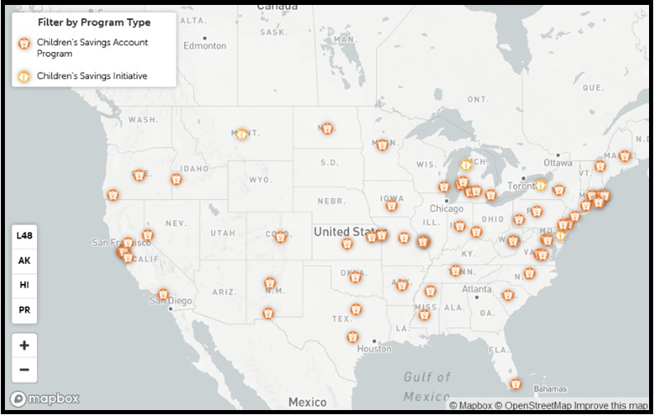
Prosperity Now
https://prosperitynow.org/childrens-savings
Notes:
Chelsea: From Prosperity Now: Over the past decade, Children's Savings Account (CSA) programs have expanded across the country, with programs in more than 34 states. One of the first was the state of Maine, whose “My Alfond Grant” program is funded by a philanthropic donor, the Harold Alfond Foundation, and gives a $500 pledge for future education to every baby born in the state. Other programs are based on smaller geographic areas, like a city, county, or specific sub-population of children or families.

Slide 7
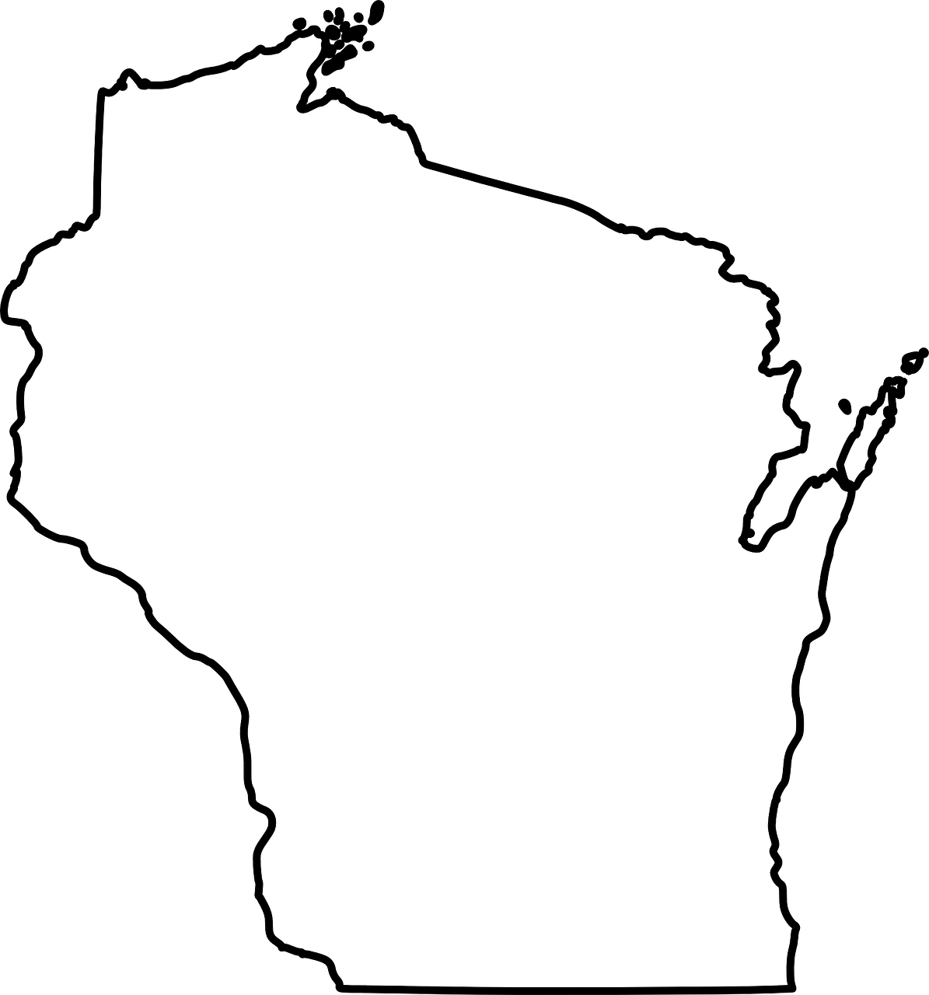

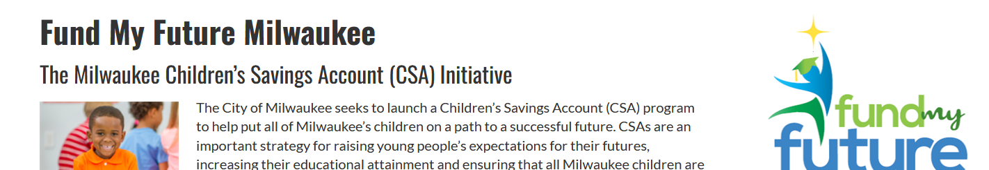
Wisconsin Programs
Notes:
Chelsea: Wisconsin has 2 Children’s Savings Account programs, and we hope to encourage more! FMFM works through the city of Milwaukee to offer a $50 deposit for MPS students when they enroll in Kindergarten.

Slide 8
Story of Success
Notes:
Paula Gruszynski to go through her handouts and explain the Future Fund program for Marinette and Menominee Counties.

Slide 9
WI 529 College Savings Program
Wisconsin College Savings Program, DFI
A tax advantaged investment program, managed by the state of WI to help families save for future education. In addition to individuals saving for their loved ones, Edvest 529 accounts can be owned by organizations who want to use the funds for CSA or scholarship programs.
This will give my children options I never had.
–Edvest account owner, Mount Pleasant, WI
Notes:
Chelsea Go through the CSP Partnership and “Why use 529 for CSA program” handouts.

Slide 10
Conversation
What would you like to see be different because of a Children’s Savings Account program?
What does success look like for your community?
Notes:
If time—a “turn and talk” to your neighbor for 5 min.

Slide 11

Partnership Opportunities
Wisconsin College Savings Program, DFI
https://finances.extension.wisc.edu/topics/youth-forward-wisconsin/
Notes:
All of us are interested in forming new partnerships with other organizations interested in starting Children’s Savings Account programs in WI.

Slide 12
Next Steps
Read and review
  https://prosperitynow.org/childrens-savings
  Making Education Work for the Poor: The Potential of Children’s Savings Accounts, by William Elliott and Melinda Lewis
Attend a Youth Forward Wisconsin (UW Extension) quarterly meeting
  Jenny.abel@wisc.edu (Nov. 15th @ 1pm on zoom)
Connect to either of us for an individual conversation.
Learn more about 529 Plans with an Edvest webinar.
Find partners in your community: funding, outreach, and admin for a potential program.

Slide 13
Questions?
Wisconsin College Savings Program

