Slide 1
Grant Catalog
Things to consider before you dive in!
Lexi Oestreich, Director of Philanthropy

Slide 2
Brief history with the Grant Catalog going into our 6th year!
# of participating nonprofits
Our fees/capacity
Name & Logo and “printed catalog”
Fundraising Goals
What we have learned along the way…

Slide 3
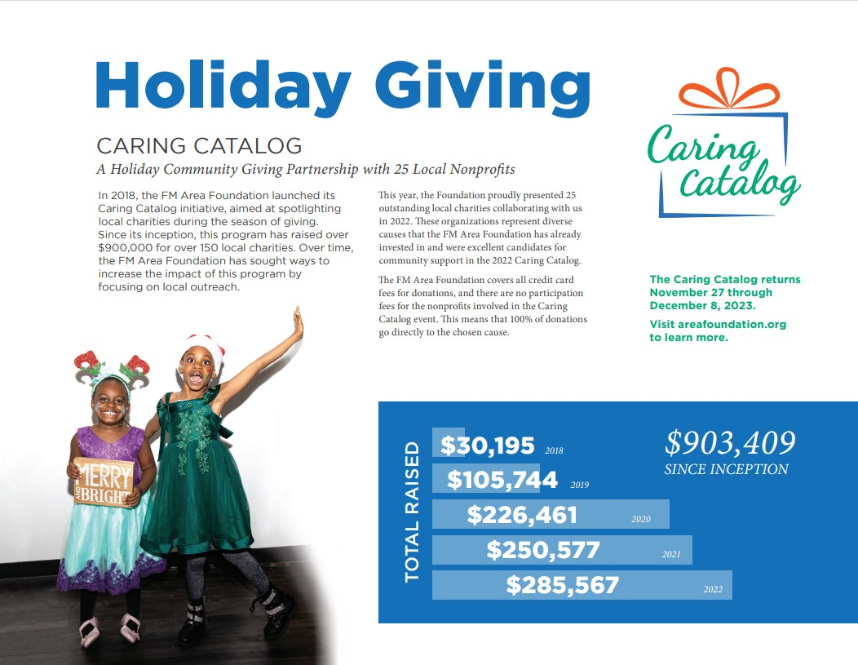

Slide 5
Strategy
Multiple ways to use the functionality
Staff Capacity
Goals of the Catalog
Primary Audience
Marketing Plans
Fundholder engagement
Sponsors?
Brand Awareness

Slide 6
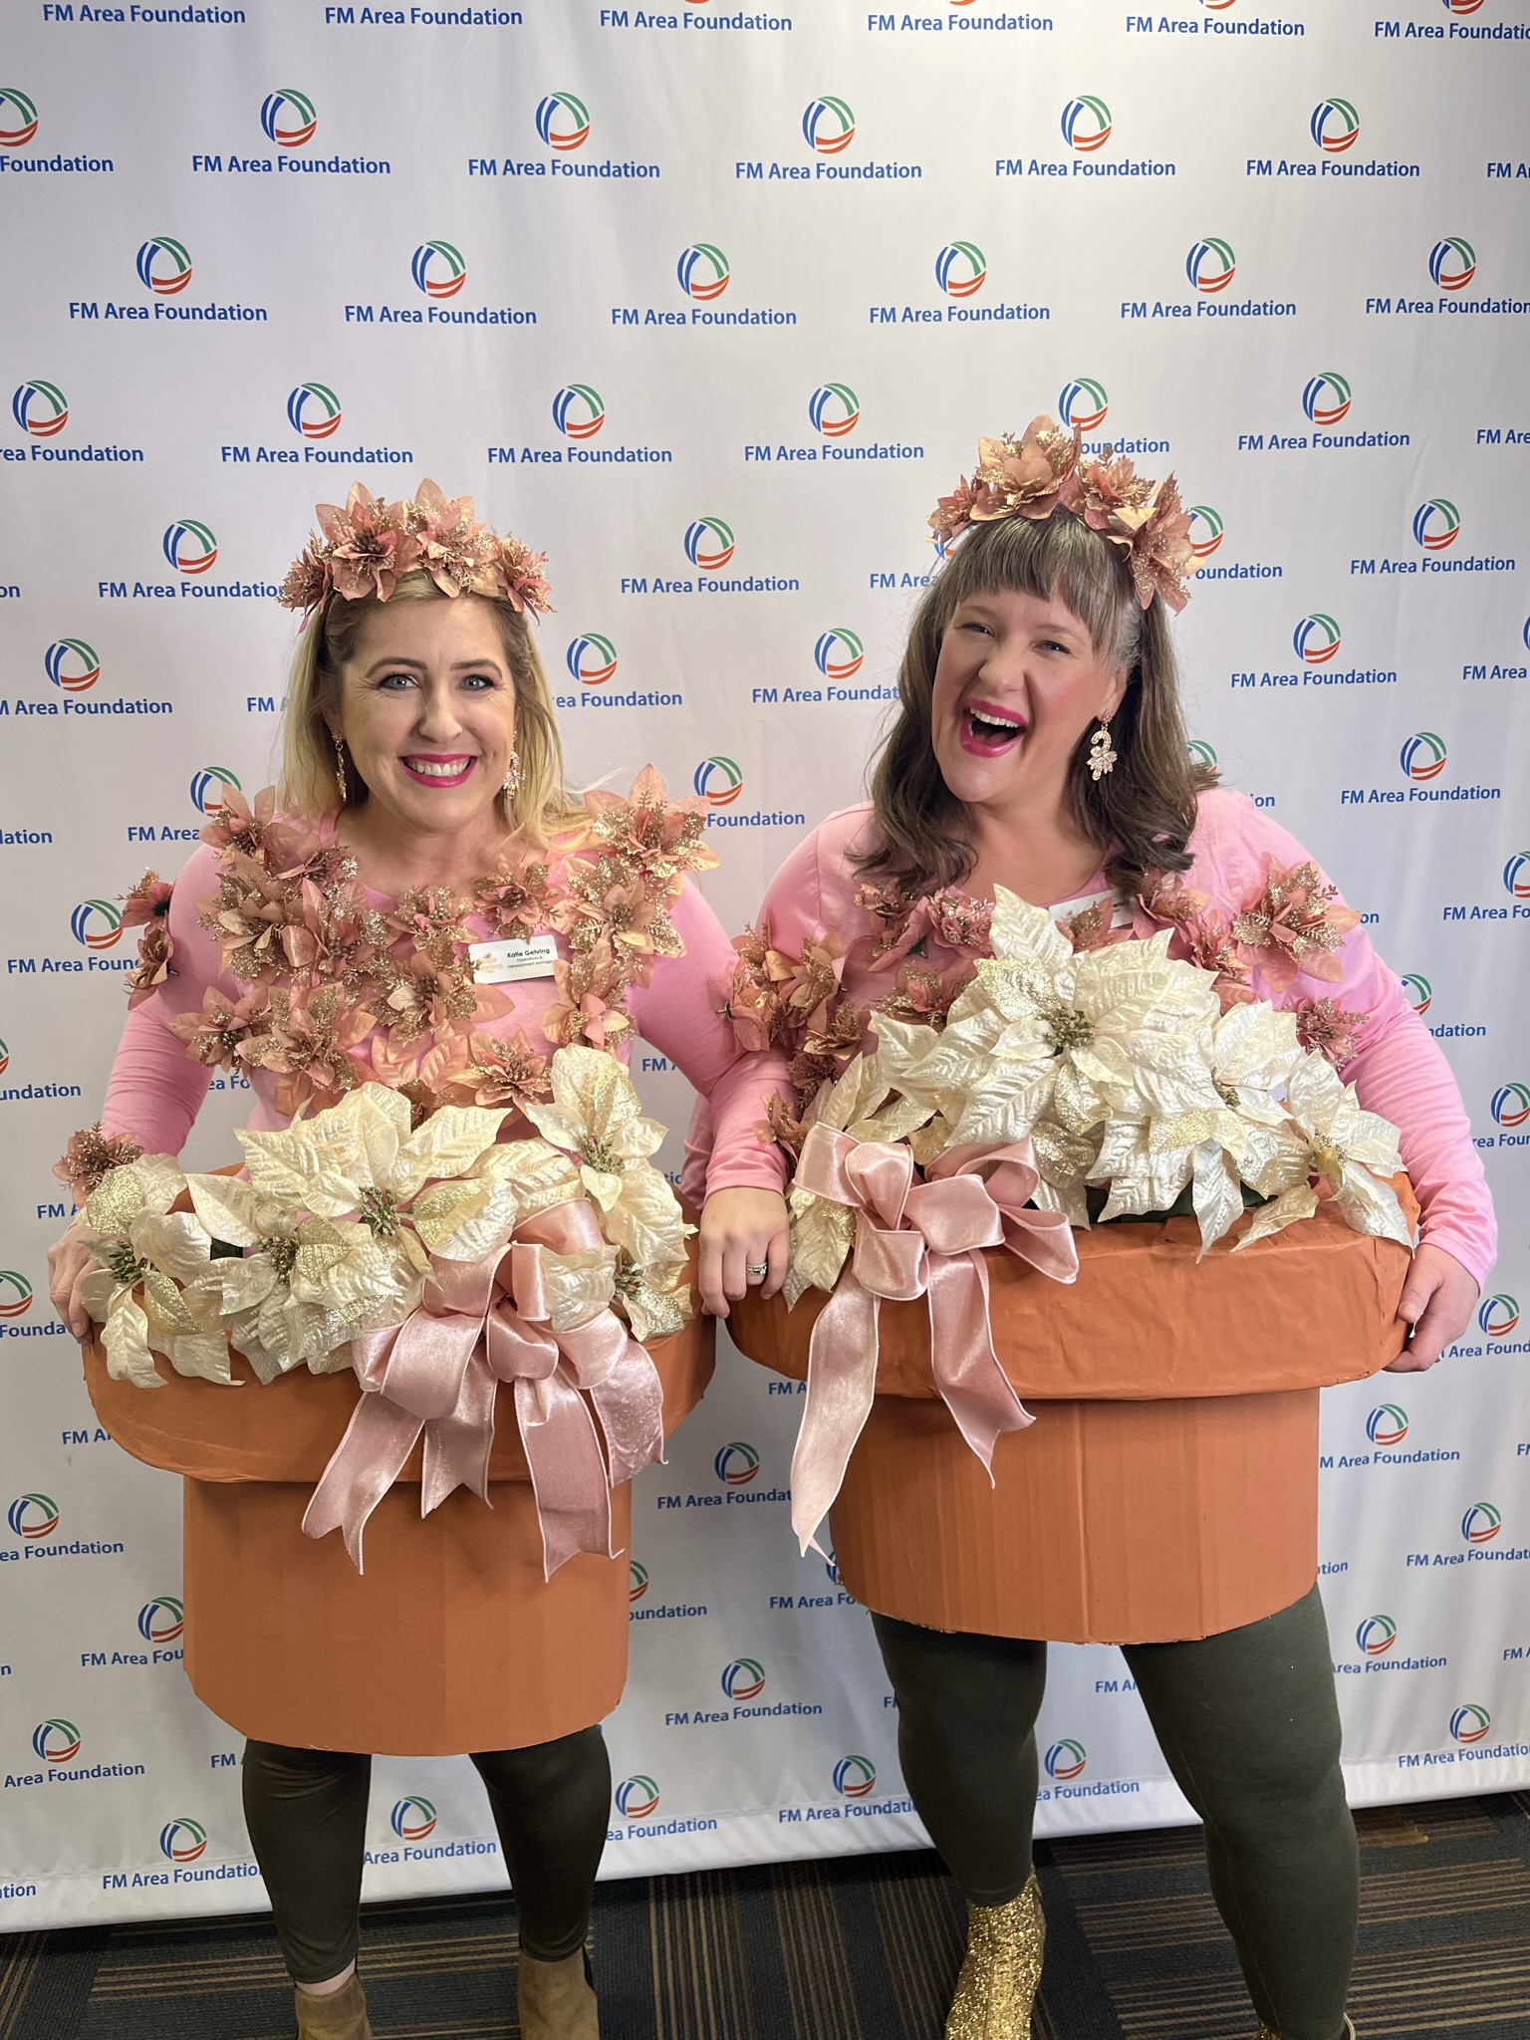

Slide 7
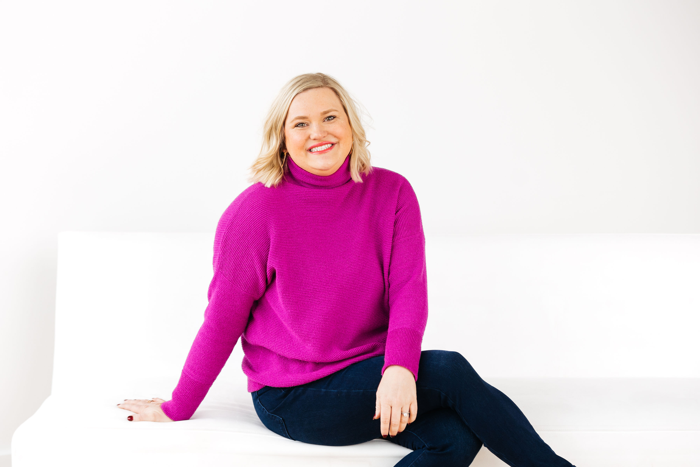
Questions?? How can I help?
Lexi Oestreich
Director of Philanthropy
FM Area Foundation

