Slide 1
It’s Not If, But When Crisis Response and Communications

Slide 2
Megan Mulholland, APR
Director of Marketing and Communications
Community Foundation for the Fox Valley Region
Owner
Compass Communications
Federal Emergency Management Agency (FEMA) certified Public Information Officer
Former Media and Public Relations Manager – ThedaCare, 17 years
2015 PRSA NE Wisconsin “Communicator of the Year”
News Journalist, for Newspapers and Radio Stations in Wisconsin

Slide 3
Background and Connection
I created a Crisis Response Plan with leadership. We trained on a tornado.
Then the pandemic hit. We also had a technology outage.
It launched in 2023 but is my second company focused on crisis communications and media relations. As a federally trained expert, I want to share my knowledge and expertise and am in demand.

Slide 4
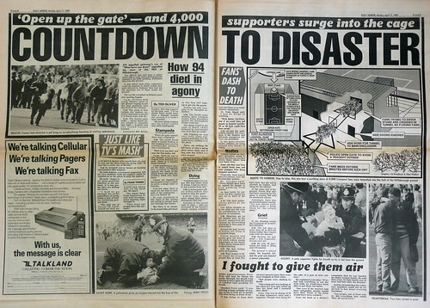
Objective: Are you prepared?
It is not IF a disaster happens, but
WHEN a disaster happens.

Slide 5
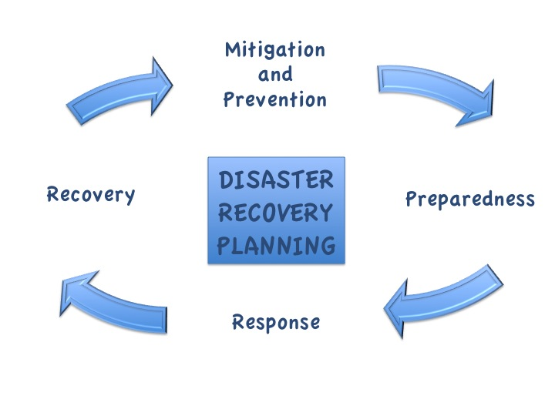
Agenda
Why
Incident Command
Crisis Response Plan
Crisis Communications Plan
Practice
Debrief
This Photo by Unknown Author is licensed under CC BY-SA

Slide 6
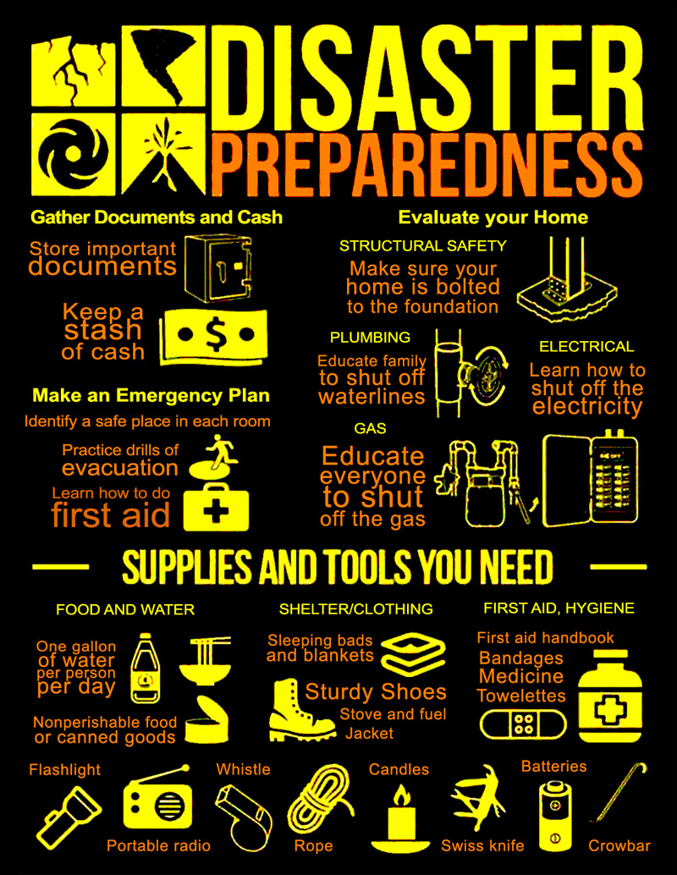
You have a plan at home
Tornado
Fire
Theft
Water Leak
Credit Card Theft
Healthcare and First Aid
Death
…And More
This Photo by Unknown Author is licensed under CC BY-NC

Slide 7
Businesses need to prepare too.
All businesses need a strategy for responding to an emergency or disaster to provide essential critical business functions and identify the resources needed to:
Ensure the safety of your personnel.
Communicate effectively with internal and external stakeholders.
Protect assets and vital records (electronic data and hardcopy).
Maintain continuity of mission-critical services and support operations.

Slide 8
Examples of crises
Natural disasters
Illegal employee activity
Political or social unrest
IT and data security
Public health concerns
What else?

Slide 9
Emerging or Emergency?
Do you have time to prepare or is it immediate?
How long will this crisis last?
1-2 Day Business Disruption: A short duration such as a service outage, major fire, or site utility failure. May affect many people for a short amount of time. All operations resume on-site in about 48 hrs.
1-2 Week Business Disruption: You may have partial access to facility and/or primary IT systems. Examples include service loss, building access loss or local utility failure. May include a regional event such as terrorism, contagious diseases or weather-related disaster. Some business operations are moved off-site. Operations resume on-site in 14 days.
Greater than 2 Week Business Disruption: A disaster including a complete loss of facility and/or primary IT systems. Regional utility failure. All critical business are operations moved off-site. All operations resume on-site in more than 30 days, or a new site is required

Slide 10
No two emergencies are identical. No single plan of action can anticipate and address every possible circumstance.
That is why you need a plan. And a team.
Consider the Incident Command model.

Slide 11
Incident Command
The Incident Command System (ICS) is a standardized approach to the command, control, and coordination of emergency response providing a common hierarchy and procedures.
ICS includes procedures for funding, personnel, facilities, equipment, and communications. Members are assigned roles. It is used from the time an incident occurs until it is resolved or mitigated.

Slide 12
Key Concepts of ICS
Unity of Command
Common Terminology
Management by Objective
Flexible and Modular Organization
Span of Control

Slide 13
Who is part of your Incident Command?
President or CEO
Human Resources
Finance
Operations
Communications
Board Member or Valued Partner

Slide 14
Examples of Roles
*Incident Commander/Deputy
*Liaison Officer
*Safety Officer
*Public Information Officer
Finance Chief
Operations or Logistics Chief
Legal Chief
Other roles: Development, Community Liaison

Slide 15
Crisis Response Plan: Create NOW before an incident happens
A plan:
Ensures everyone is on the same page, working toward set goals for a set time.
Includes measurable, strategic objectives.
Ensures a coordinated response.
At the simplest level, all plans have four elements:
What do we want to do?
Who is responsible for doing it?
How do we communicate with each other?
What is the procedure if someone is injured/an expense is incurred, etc.?

Slide 16
Aspects of Crisis Response Plan
Create and train an Incident Command Team
Role Descriptions
Risk Assessment
Prepare Needs for Mission-Critical Services
Records
Communications
Building Evacuation
Emergency Operations Center
Business Recovery Locations
Information Technology (Data, Software, Hardware)
Other Business Procedures
Activation Plan
Mutual Aid
Checklist
Create Emergency Personnel Policies
Drill/Practice
Debrief

Slide 17
Crisis Response
Activate the plan when necessary to manage or coordinate a disaster response.
Assign roles and determine how meet, when, where, etc.
Determine safety of employees and others affected.
Analyze impact on business.
Set objectives to get to recovery and then mitigation.
Communicate and document process and outcomes.

Slide 18
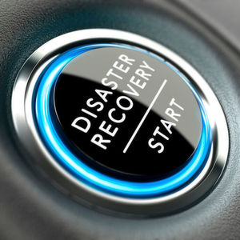
Crisis Communications
Effectively manage communications to mitigate crisis and maintain reputation.
Objectives:
Prepare to effectively, nimbly and authentically respond
Help staff respond in a unified, professional manner
Strategically enhance brand and value
Manage distribution of critical information to media, customers and other stakeholders

Slide 19
Crisis Communications Plan/Policy
Reviewed annually
How you report a crisis
Who communicates to the public
Who manages the crisis
How respond (tone, email, video)
When respond (ideally proactive)
No comment alternatives
Personnel matters remain confidential

Slide 20
Crisis Communications
Assess the situation, determine facts, delegate, ask questions
Develop key messages
Notify staff, board, key partners, media

Slide 21
Crisis Communications
Keep records
Evaluate messaging
Update communications
Evaluate management of crisis
Post-crisis clean up

Slide 22
Checklist
Who is the lead
What are the facts
What is the response/action
Create plan for internal and external communications
Prepare talking points and message
Determine if need news release, social media, etc.
Determine resources needed (cell phones, conference rooms, web page)
Appoint team/staff

Slide 23
Checklist
Contact key stakeholders (like board and staff)
Do outreach to media, government leaders
Update web, social media, voice mail, etc.
Evaluate effectiveness of messaging
Implement methods to update audiences ongoing
Communicate post crisis

Slide 24
Preparing for a Crisis
Phone/Email List
SWOT analysis
Media Training
Crisis Management Checklist
Key Audience and Media List
Key Messages
Pre-Approved Statements
Emergency Personnel
Off-Site Alternatives
Equipment
Drill

Slide 25
Post-Crisis Review
Secure Loose Ends
Recognize Heroes
Review Crisis Communications
Assess Media Coverage
File and Update

Slide 26
Messaging

Slide 27
Practice: Scenario
National Weather Service says an ice storm is coming!

Slide 28
Questions?

Slide 29
Thank You!
Megan Mulholland, APR
Director of Marketing and Communications
Community Foundation for the Fox Valley Region
Owner
Compass Communications
LinkedIn - linkedin.com/in/megan-mulholland-apr-9760918
Email: mmulholland@cffoxvalley.org or mjo15bmw@yahoo.com

