Slide 1
Capacity Building Opportunities

Slide 2
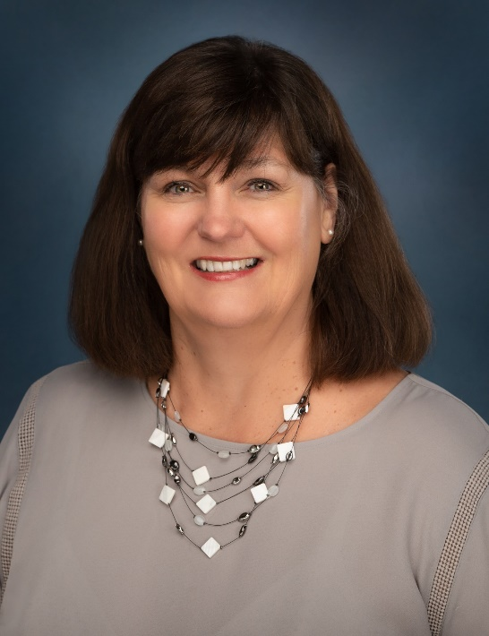
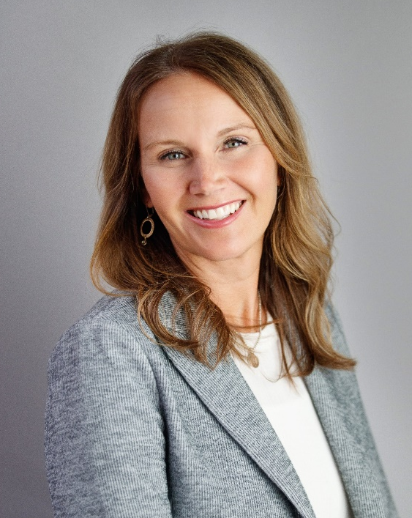
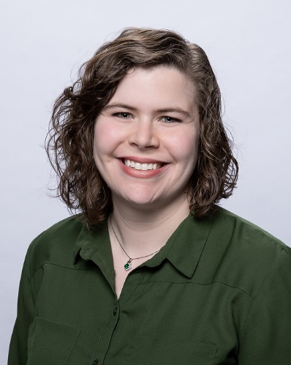
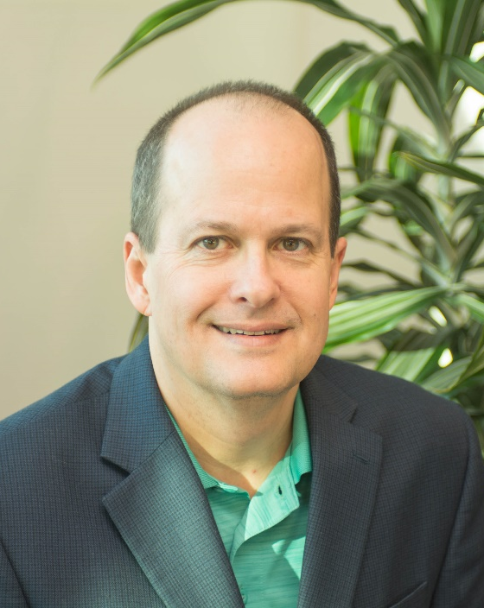
Capacity Building Panel Discussion
Sue Nelson
VP of Program & Donor Services
Community Foundation of
North Central Wisconsin
Angie Pilgrim
Director of Community Impact
St. Croix Valley Foundation
Carolyn Desrosiers
Community Engagement Manager
Community Foundation
for the Fox Valley
Ted Bilich
Founder and CEO
Risk Alternatives, LLC

Slide 3
GROUND RULES
Commitment to honor confidentiality
When contributing to the conversation
Introduce yourself / your foundation / and your role
Keep your responses to 45 seconds
Capacity Building Opportunities
Give-Grow-Grant Regional Conference

Slide 4
WHAT IS CAPACITY BUILDING
“Capacity building is whatever is needed to bring a nonprofit to the next level of operational, programmatic, financial, or organizational maturity, so it may more effectively and efficiently advance its mission into the future.”
National Council of Foundations
Capacity Building Opportunities
Give-Grow-Grant Regional Conference

Slide 5
SHOW OF HANDS
How does your Foundation Rank in Addressing Capacity Building for Nonprofits in Your Community?
High….We are rocking it!
Medium…Eh, we’re doing ok
Low…We need some help in this area
Capacity Building Opportunities
Give-Grow-Grant Regional Conference

Slide 6
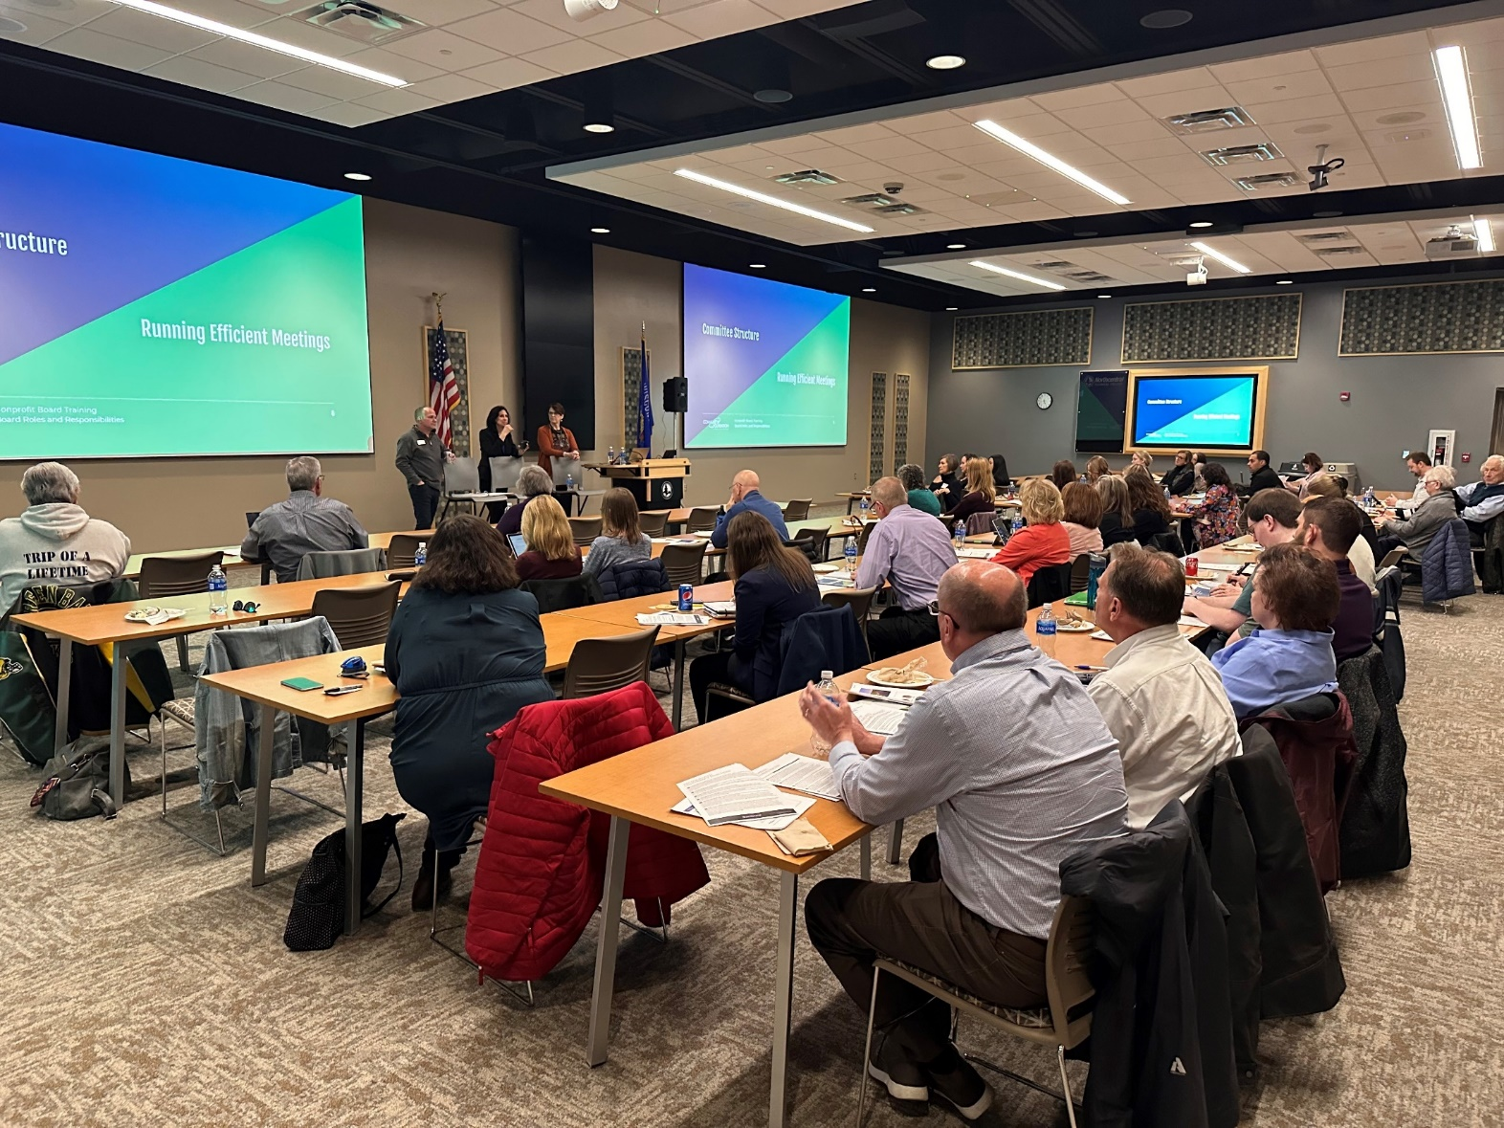
Put Our Money Where Your Mouth Is
Funding Source
Educational Opportunities
Networking and Collaboration
Capacity Building Opportunities
Give-Grow-Grant Regional Conference

Slide 7
Based in Wausau, WI, founded in 1987
$72M Assets / 435 funds
Marathon County and all regions north
Funding Source:
Simplify the application process
Provide information on funding opportunities
Educational Opportunities:
Nonprofit Management Institute
Lunch & Learn Series
Networking and Collaboration:
Community Connect
Nonprofit Exchange
Capacity Building Opportunities
Give-Grow-Grant Regional Conference

Slide 8
Based in Hudson, WI, founded in 1995
$87M Assets
6-County Region / 10 Affiliates
Capacity Building Efforts over the Years:
Partners for the Future
Capacity Building Grants: software/hardware, consulting, staff, etc.
Nonprofit Workshop
Nonprofit Leadership Certificate
Capacity Building Opportunities
Give-Grow-Grant Regional Conference

Slide 9
Consultants in Service (CIS)
Launched in 2017
Match volunteer consultants with nonprofit need (1:1)
Strategic Planning
Fundraising
Board Development/Governance
CIS on the Road
Feature popular topics
Network & Community Building
https://www.scvfoundation.org/cis-for-nonprofits
Capacity Building Opportunities
Give-Grow-Grant Regional Conference

Slide 10
Based in Appleton, WI, founded in 1996,
4.5 county region
Capacity Building Efforts over the Years:
Strategic Planning Grants
“Move to the Cloud” Grants
“Tech Fund” collaboration with Microsoft – support for IT managed services
DEI Training/Consultant Grants
Capacity Building Grants: 2-year large grants supporting staff additions, software implementation, etc.
Spearheaded the Nonprofit Leadership Initiative
Capacity Building Opportunities
Give-Grow-Grant Regional Conference

Slide 11
2013 -Effort began; 2015 - Program of CFFVR w/ first FT Staff; Now 3 FT Staff
Serves Fox Valley Nonprofit staff, Board, and volunteers
Funded collaboratively (CFFVR, United Way, Corporate Foundations)
Programming areas:
Leadership Development (Leadership Institute, Board Academy, etc.)
Resources (Jumpstart, Online resource bank, Board connect website)
Network & Community Building (cohorts, user groups)
www.npleadershipfv.org
Capacity Building Opportunities
Give-Grow-Grant Regional Conference

Slide 12
RISK ALTERNATIVES LLC
Based in Madison, providing risk management and process improvement, strategic planning, coaching
Work with foundations across the US to help grantees
Interviewed more than 100 foundation executives about capacity building best practices
Capacity Building Opportunities
Give-Grow-Grant Regional Conference

Slide 13
Capacity Building Conversation

Slide 14
Q&A
What capacity building do you offer currently?
What are you hearing from your nonprofits about capacity needs?
What capacity building gaps exist in your region?
Capacity Building Opportunities
Give-Grow-Grant Regional Conference

Slide 15
Q&A
Is there a need for a statewide nonprofit capacity-building organization?
Are you interested in continuing this conversation virtually in the future?
Capacity Building Opportunities
Give-Grow-Grant Regional Conference

Slide 16
THANK YOU PANEL
Angie Pilgrim
Director of Community Impact
St. Croix Valley Foundation
Carolyn Desrosiers
Community Engagement Manager
Community Foundation
for the Fox Valley
Ted Bilich
Founder and CEO
Risk Alternatives, LLC

Slide 17
Coming Up Today
Noon Lunch
1:00 Breakout
2:00 Breakout
3-6 Granite Peak Reception (cash bar)
Fall Color Chairlift Rides
6:30 Dinner at the Hilton

