Slide 2
Be Amazing is a
nonprofit organization that got its start in the Central Wisconsin area in May of 2017.

Slide 3
In the beginning, a class of fifth grade students decided that “being amazing” meant helping others.

Slide 5
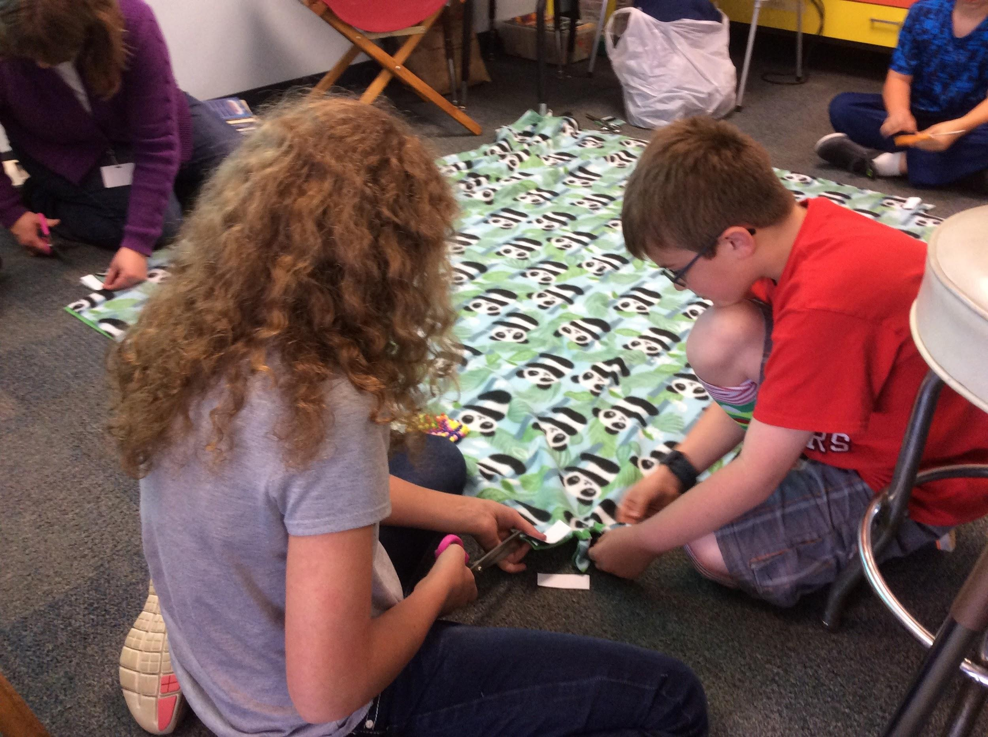
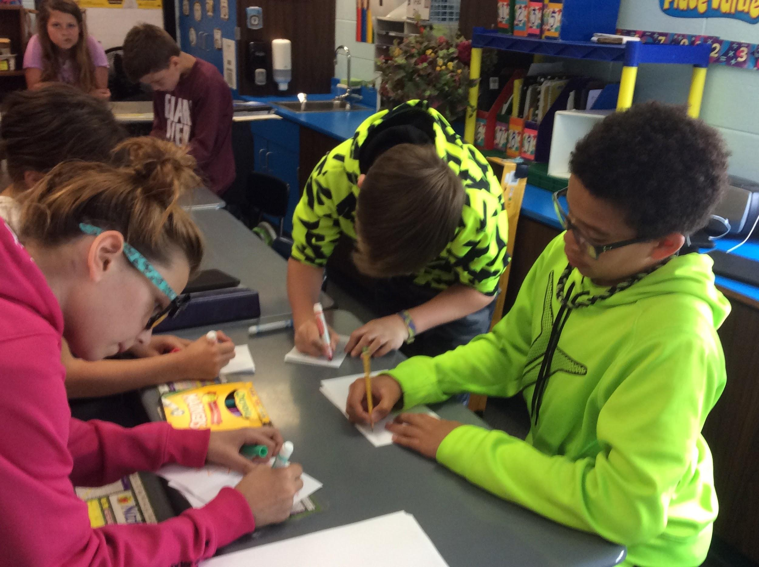
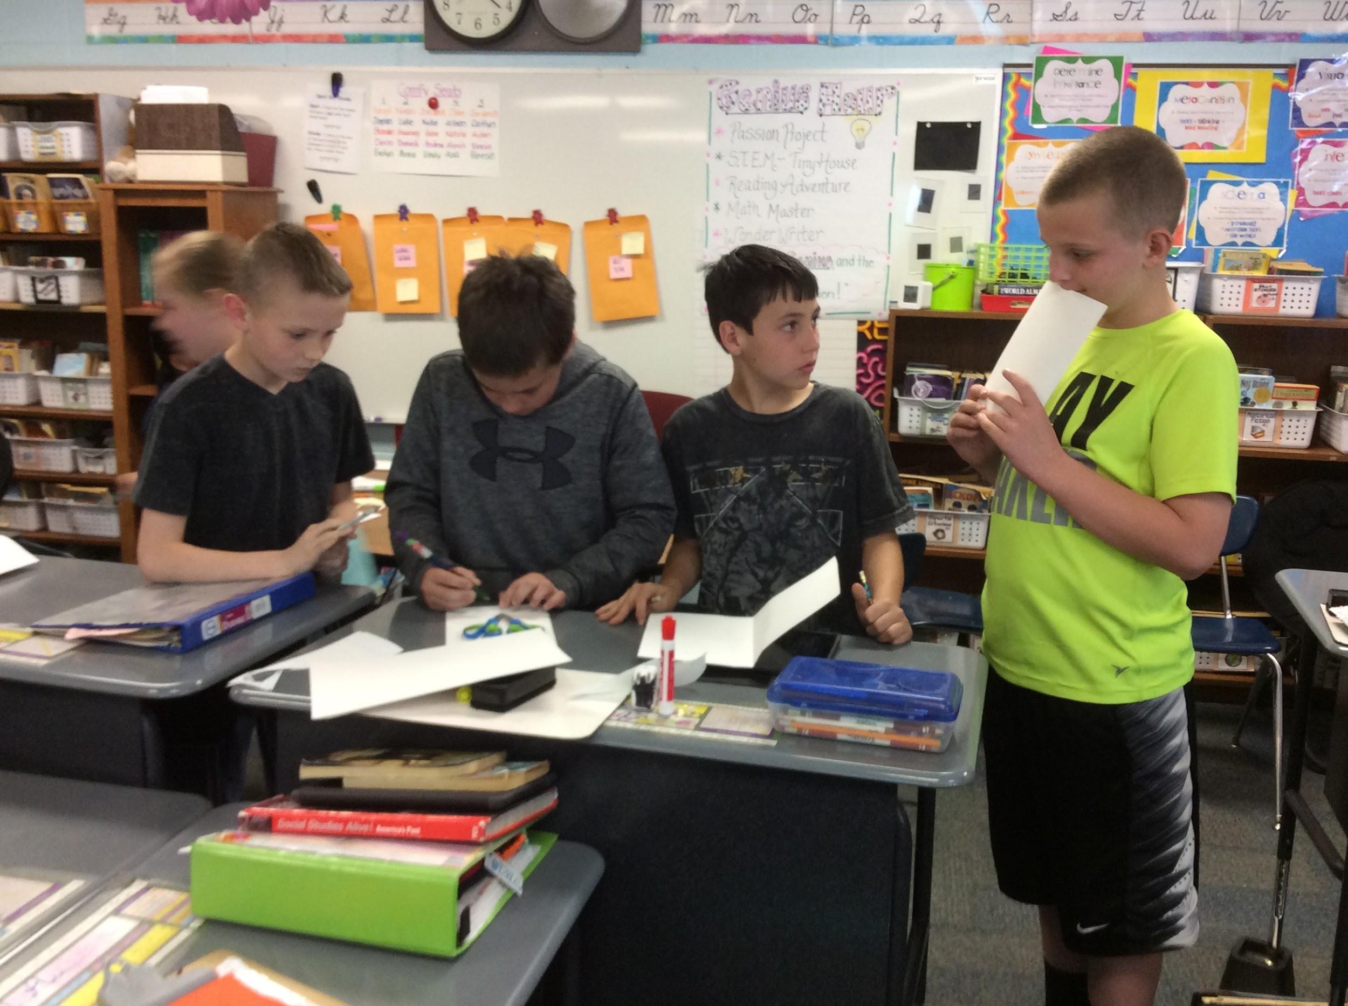
They planned and completed service
projects directed toward groups having various needs throughout our community.

Slide 6
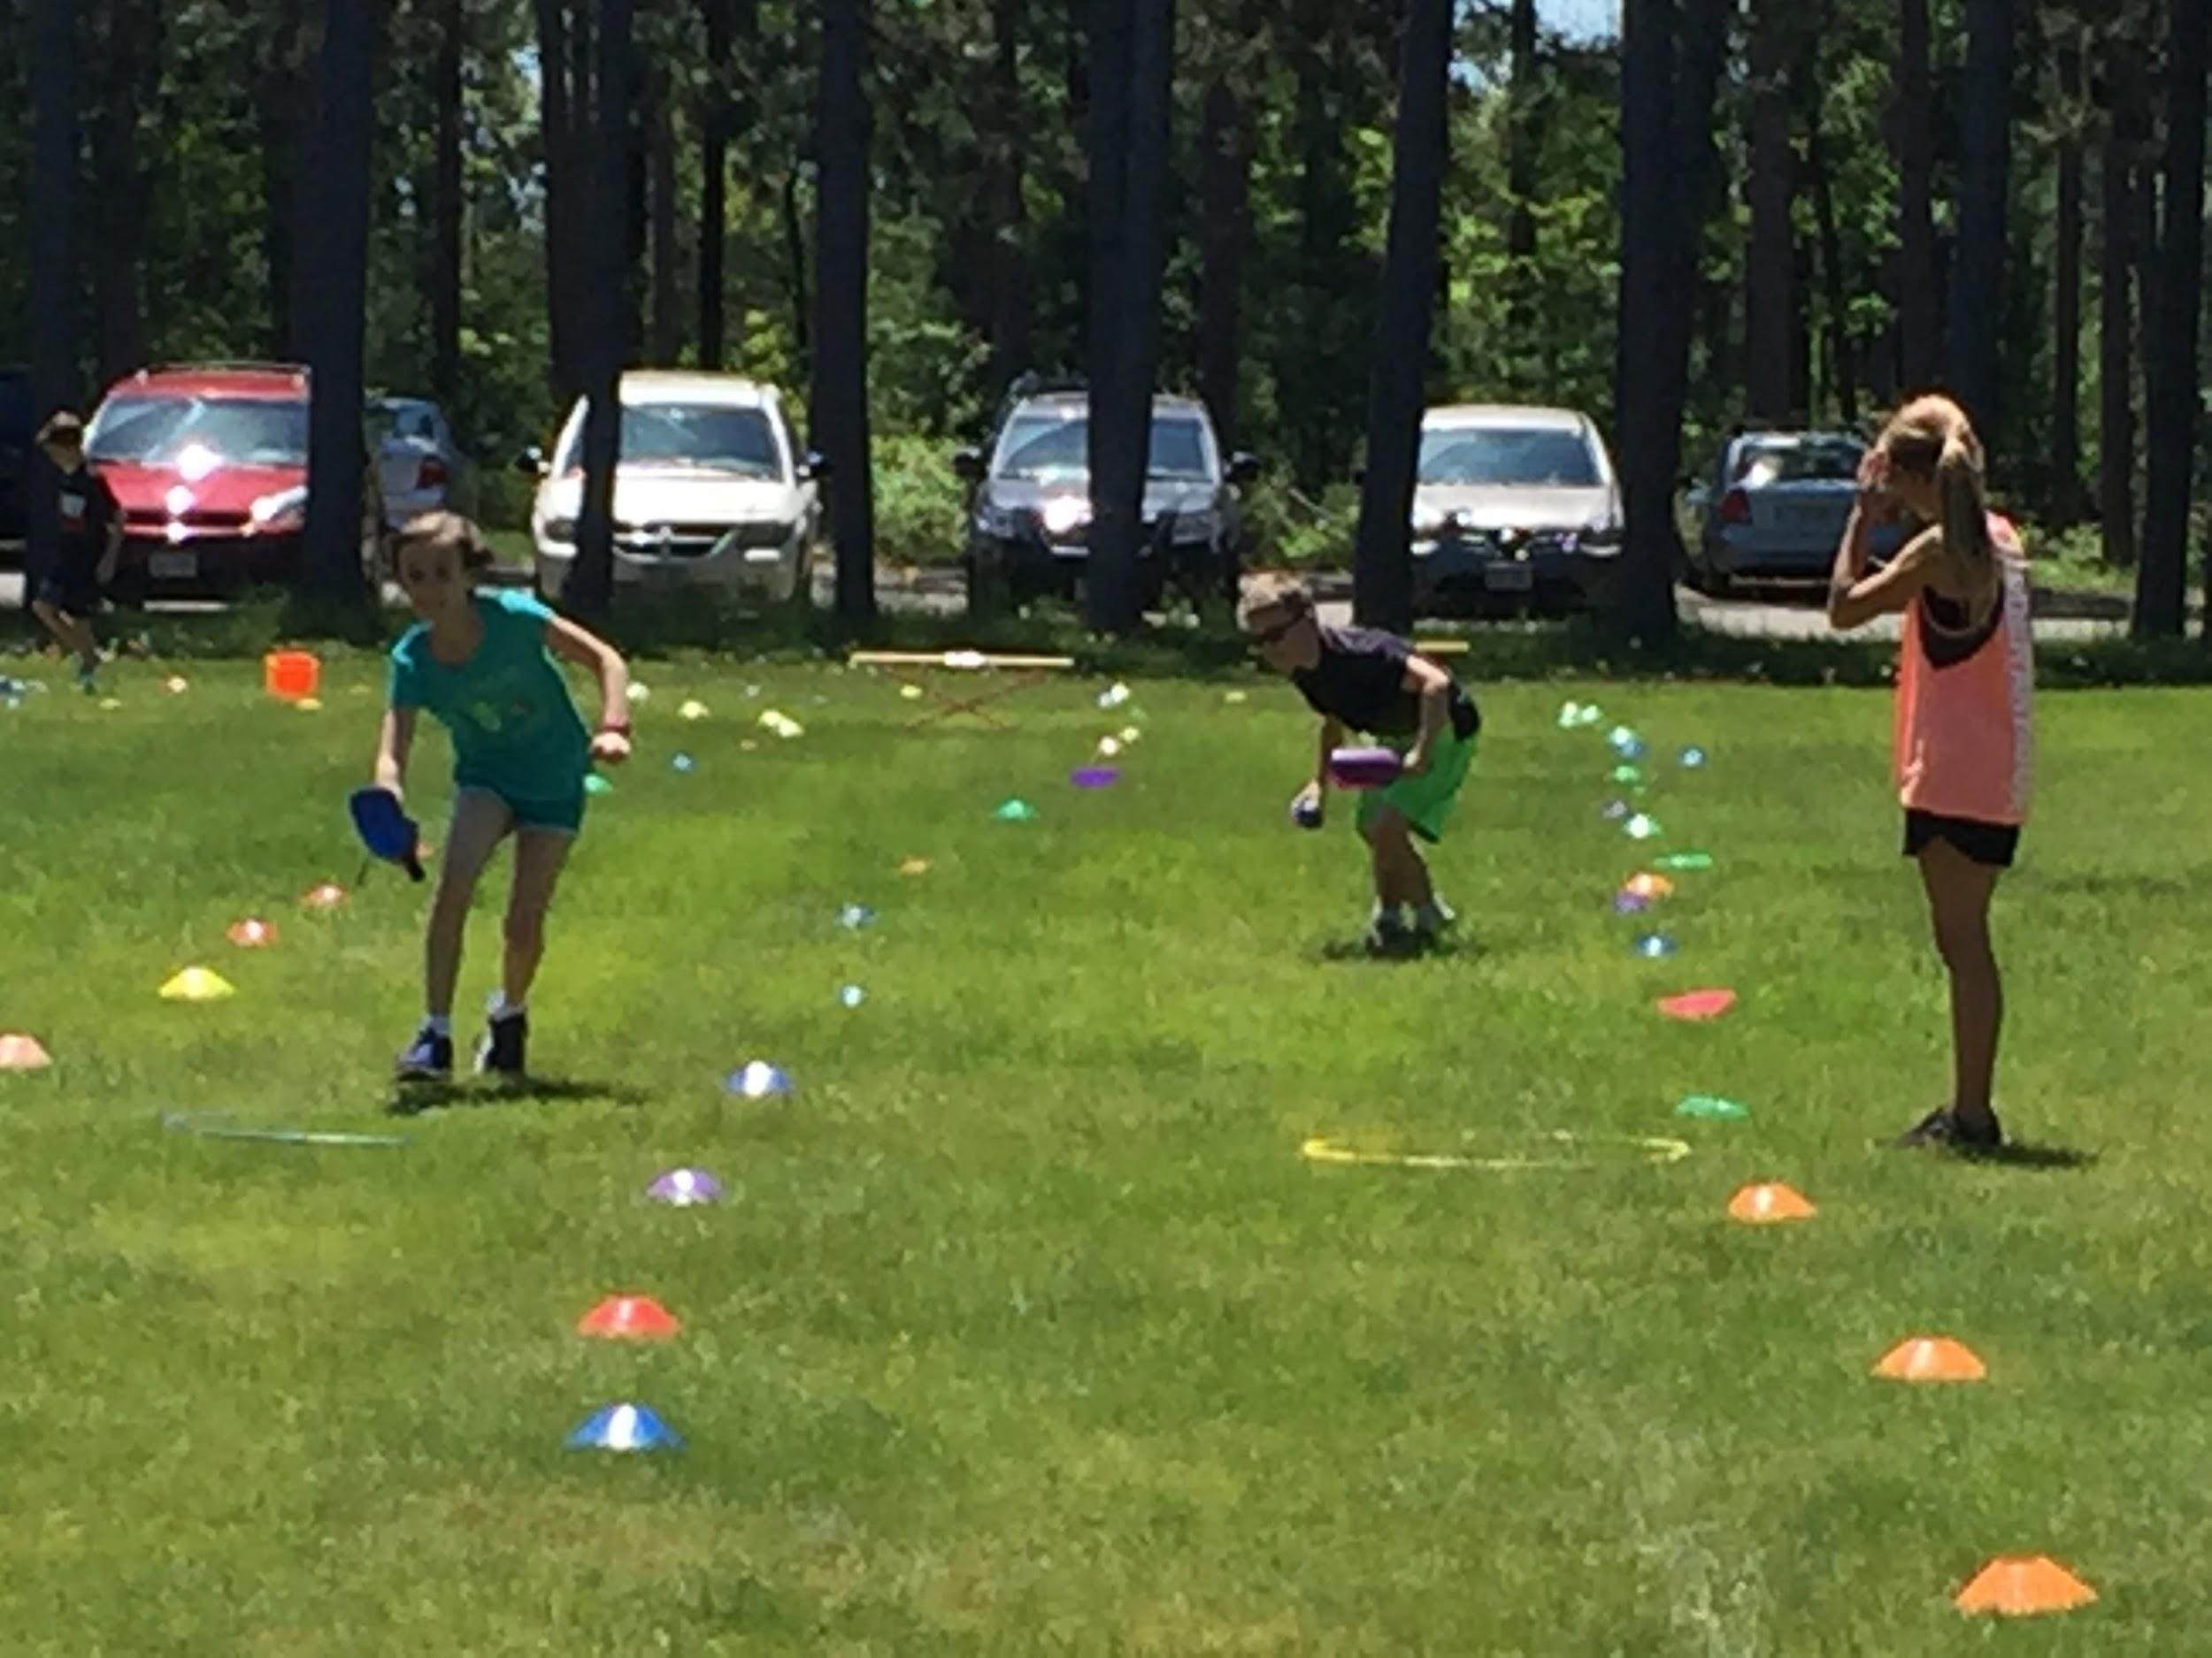
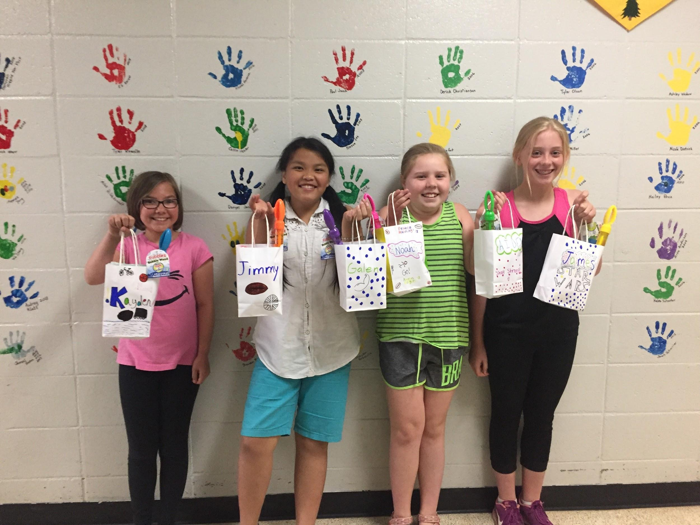
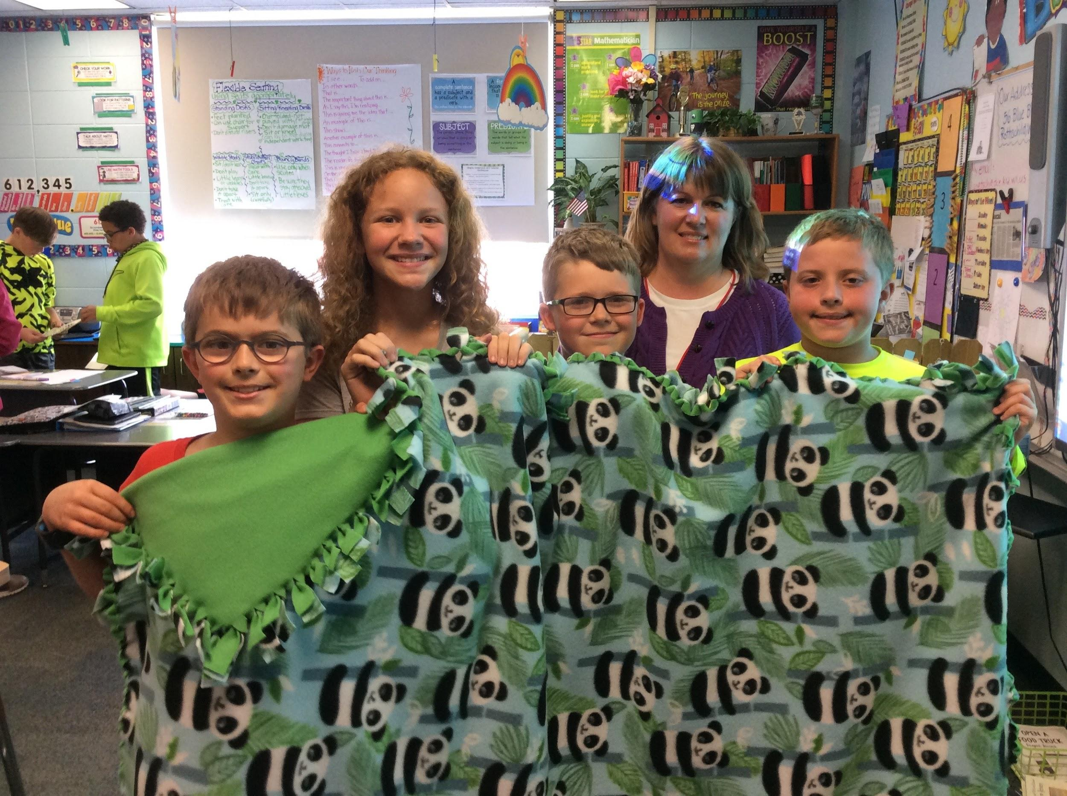
Their projects were completely student driven.
Making and donating
fleece blankets to
hospital patients.
Creating an obstacle course
for students to compete in
to raise money for
Special Olympics.
Creating and filling gift
bags for special needs
students and having a
celebration with them.

Slide 7
As they completed their year in 5th grade, one proud accomplishment for each of them was knowing they had made a difference in the lives of others in amazing ways.

Slide 8
As word spread, more people became interested in ways to make positive change, and the Be Amazing group became a reality!

Slide 9
Our Purpose
is to promote the desire to help others who may be in need by building awareness and providing education and financial support.

Slide 10
Our Mission
is to empower and inspire people of all ages to create positive change.

Slide 11
Our Goal
is to encourage and recognize acts of kindness, support community service projects and promote positivity.

Slide 12
Our Core Values are:
Kindness
Respect
Integrity
Inclusion

Slide 13
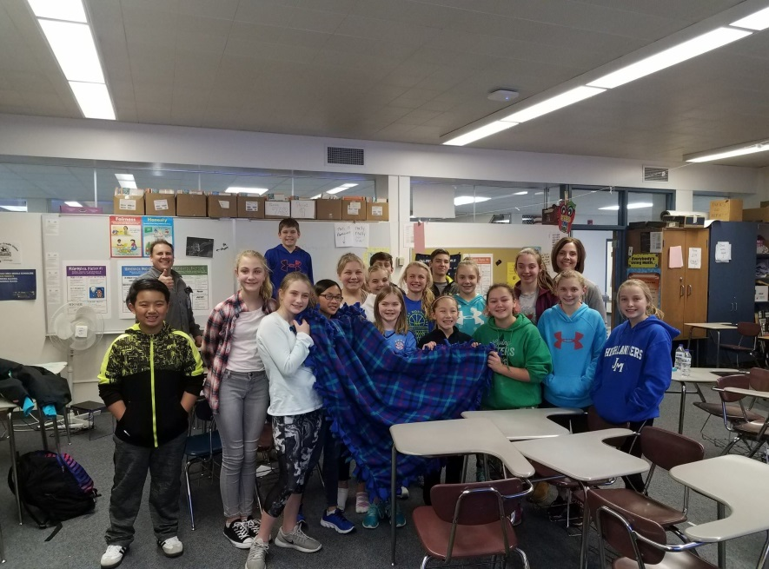
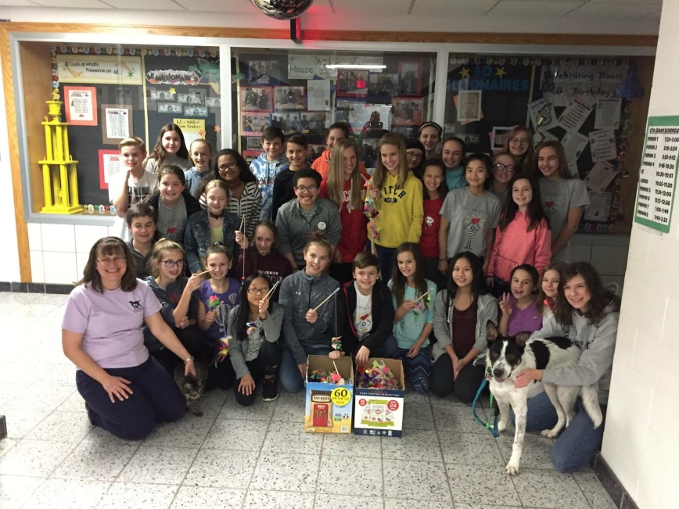
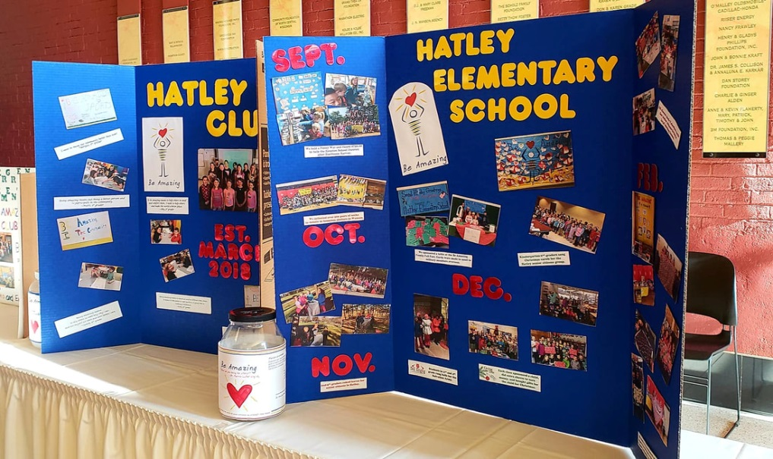
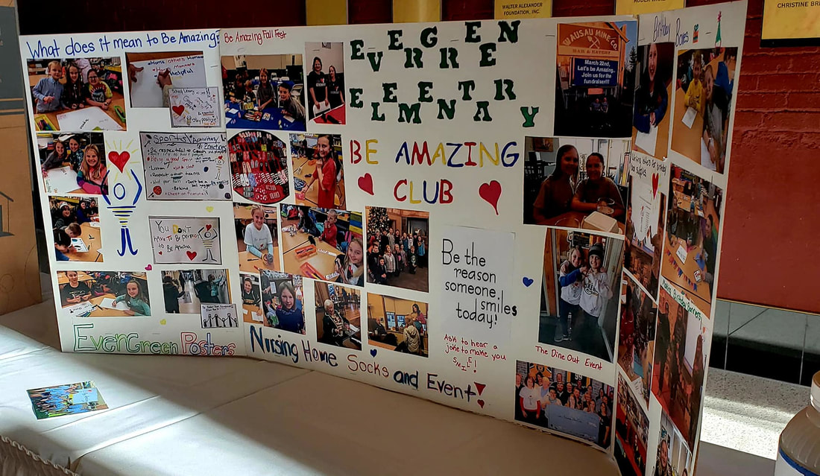
School Clubs

Slide 14
School Clubs
Our focus is to empower and inspire our youth to create a kinder world.
We work with them to build leadership skills by giving them voice and choice in the projects they develop and carry out.

Slide 15
School Clubs
There have been up to 13
school-based clubs!!
Grades 1-12
Throughout 3 area school districts
Notes:
There are approximately 13 Be Amazing clubs throughout central Wisconsin. The clubs range from elementary to Junior High level.
Are you interested in starting a club at your school?
Some things to think about…
Advisor(s)
Should be someone with the same passion as Be Amazing’s mission, vision and values
Time commitment
Members
How many should you have? This may be determined by age groups and/or how many you are willing and able to manage

Slide 16
Project Funding
A concern of the original group of students!!
Notes:
Be Amazing started as a small idea of a 5th grade teacher at Evergreen Elementary school. Through taking to and asking her students what Be Amazing means. One idea that stood out was “helping those in need”. In small groups, they worked diligently for 8 weeks to complete projects to help groups of people they viewed as in need of help. As they completed their year in 5th grade, one proud accomplishment for each of them was knowing they had made a difference in the lives of others in amazing ways. Their projects were completely student driven, and included the following efforts:
Making and donating fleece blankets to hospital patients
Making get-well cards for hospital patients and visiting with them
Creating an obstacle course for students to compete in to raise money for Special Olympics
Creating “comfort kits” for grieving families and visiting with them
Creating and filling gift bags for special needs students and having a celebration with them
Creating cards to send to War Veterans
As word of these activities spread more people became interested in developing ways for members of our community to do amazing things, and the “Be Amazing” group became a reality. The “Be Amazing Fund”, a 501c3 non-profit fund through the Community Foundation, was established to provide monetary support for those individuals and/or groups wanting to make such a difference.

Slide 17
Project Funding
The Be Amazing Fund
The purpose of the fund is to enable individuals/groups to complete projects that positively impact the community.
.

Slide 18
What’s Next for Be Amazing?
Increasing the number of our school-based clubs throughout the surrounding school districts.

Slide 19
What’s Next for Be Amazing?
Increasing the number of our school-based clubs throughout the surrounding school districts.
Building a partnership with
Multiplying Good-Students in Action.

Slide 21
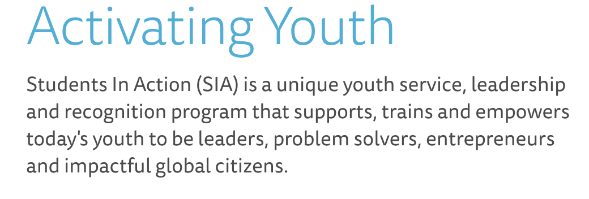

Slide 23
What’s Next for Be Amazing?
Increasing the number of our school-based clubs throughout the surrounding school districts.
Building a partnership with
Multiplying Good-Students in Action.

Slide 24
What’s Next for Be Amazing?
Increasing the number of our school-based clubs throughout the surrounding school districts.
Building a partnership with
Multiplying Good-Students in Action.
Bring Students in Action to Wisconsin

Slide 25
What’s Next for Be Amazing?
Increasing the number of our school-based clubs throughout the surrounding school districts.
Building a partnership with
Multiplying Good-Students in Action.
Bring Students in Action to Wisconsin
STUDENTS IN ACTION
POWERED BY BE AMAZING

Slide 26
What’s Next for Be Amazing?
Building a partnership with
Multiplying Good-Students in Action.
Bring Students in Action to Wisconsin
STUDENTS IN ACTION
POWERED BY BE AMAZING
The Be Amazing clubs will be the “feeder clubs” for Students in Action

Slide 27
The Be Amazing organization is thankful for the community support we have received over the past 6 ½ years.

Slide 28
We are looking forward to the future and hope to have many opportunities to empower and enable community members of all ages to make the world a kinder place.
Notes:
.
Individuals interested in donating to Be Amazing you can make a tax-deductible donation to the Be Amazing Fund through the Community Foundation of North Central Wisconsin (500 1st St. #2600, Wausau, WI 54403, Attn: Be Amazing). Donations can also be given at cfoncw.org or www.beamazing2day.com.
Follow us on the Be Amazing website, Facebook, Twitter and Instagram pages for upcoming events and volunteer opportunities.

